Slide 1
Software Engineering
Topic 6:
Verification: Testing and Analysis
Your Name: _____________________
Computer Science & Engineering Department
The Chinese University of Hong Kong

Slide 2
The Need for Verification
The product of any engineering activity must be verified (shown to be correct) according to its requirements throughout its development
Verifying s/w is perhaps more difficult than verifying other engineering products
Software verification and validation (V&V) cost 40% or more of the whole software development
Notes:
In this topic we will focus on verification techniques for software. Verification includes testing and analysis.
During the design and construction of, say, a bridge, one must repeatedly verify the product in all its intermediate development stages. For instance, the first blueprints of the bridge are verified by using suitable equations to forecast whether the bridge will sustain the required loading. Possibly, a physical model is also built, to further enhance the reliability of the forecast. The raw materials used in the construction are inspected, and their quality is verified. The construction process is also verified for its adherence to certain required standards. Finally, in some cases, the real bridge is checked by loading it with a number of trunks of a given weight before opening it to the public.
As we said, not only the products of bridge design and construction are verified but even the process must be checked. For instance, before starting the actual construction of the bridge, one should verify that the building site has been prepared appropriately – perhaps including schools for the children of the workers if the bridge has to be built in an undeveloped area. There are even government agencies that must approve the design before any work can begin. The site, likewise, must be prepared by the contractor and approved by an appropriate agency.
Software must be verified in much the same spirit. In this topic, however, we shall learn that verifying software is perhaps more difficult than verifying other engineering products. We shall try to clarify why this is so.
The topic is devoted to software verification. We first discuss the goals and requirements of the verification activity and then present, compare, and evaluate major verification techniques.

Slide 3
The Need for Verification
Verification – Are we building the product right?
  based on requirements (documents)
  “辨证”
Validation – Are we building the right product?
  based on customers (real users)
  “確認”
Comparison
Q: Which one is more difficult?
A: Validation (which is beyond the scope of this topic)
Notes:
Here we firstly discuss some issues regarding terminology. The field of software verification is progressing rapidly, and the terminology is evolving. The terms verification and validation, in particular, are used with many, often inconsistent, meanings. We shall avoid the term validation and only use verification in this topic. By verification, we mean all activities that are undertaken to ascertain that the software meets its objectives. As we shall see, these activities encompass a wide spectrum of efforts, including testing , mathematical proofs, and informal reasoning.
At the beginning of the topic, we shall use the terms error and defect interchangeably in place of the more common and affectionate (but sloppy) term, “bug”. We shall define these and other terms more precisely later in the topic.

Slide 4
Goals and Requirements of Verification
Everything must be verified
  Verifying: - code
  - spec (simulation or property analysis)
  - process
  - the verification itself
  - software quality (portability, understandability, performance, etc)
  Verification may be performed
  - at different points of time
  - by different people
  - with different goals
  - by using different techniques
Notes:
In some sense, even verification must be verified. In fact, once we have tested a system for proper behavior, we should check whether our tests were executed properly themselves. Verifying the validity of experiments is standard practice in established scientific disciplines. Going back to the bridge example, after having tested the strength of the bridge in several cases, we should check whether all the experiments have been carried out in the right way and whether more experiments are needed. Similarly, if we have been able to prove some desirable property of a system we are working on, we must critically analyze whether the proof we made is “correct”. Of course, such a “recursive” application of the verification activity must eventually stop.
Also, every software quality must be verified. Not only must we check, through verification of correctness, whether the software we have implemented behaves according to the specification document(s), but also, we must certify the software’s portability, performance, modifiability, etc.

Slide 5
Goals and Requirements of Verification
The results of verification may not be binary
  not merely a “yes or no” result
  product correctness (compliance with functional spec) is a matter of __degree___
    The presence of defects in large and complex software cannot be avoided completely
    Some defects can be tolerated (“__features__”)
    Correctness is relative, but hard to measure
  other s/w quality, e.g. efficiency, has several levels
Notes:
We tend to think of verification as a “yes or no” activity: After having performed as many tests as needed and as much analysis as required, eventually the result of the verification is either acceptance or rejection of the final product. Even though it is true that, ultimately, the producer either decides to deliver the product or decides not to and the user either decides to accept it or decides not to, there are many verification activities whose results cannot be reduced to a binary answer.
As we observed in Topic 2, even correctness itself (i.e., compliance with functional specifications) is a matter of degree. In other words, it cannot be stated that a piece of software is absolutely error free, but an approximation of ideal correctness is often considered satisfactory and may in some way be certified. It is common to hear or read sentences such as “The new release of this product corrects several errors.”(That is, the new release is more correct than the previous release.) This claim implies that:
The presence of defects in large and complex software cannot be avoided completely in practice.
Sometimes, some defects can be tolerated.
In practice, correctness is relative. Unfortunately, this does not imply that it is easy to measure.
Efficiency is a typical example of a software quality that can be exhibited at different levels. Efficiency is often explicitly mentioned in requirements documents and can be measured in several ways. For instance, efficiency could be expressed in terms of complexity by a formula such as “The time required to perform computations is given by the function f(n) of the length n of the input stream”; or one could experimentally build tables that state the number and kind of resources needed to run a system in several representative cases.

Slide 6
Goals and Requirements of Verification
Verification may be objective or subjective
  Objective verification: performing a test data measuring the response time; correctness ; reliability
  Subjective verification:
    Portability
    Maintainability
    Reusability
    Understandability
    User-friendliness
_A_
_A_
_A_
_B_
_B_
Two main factors
A: environment-dependent
B: need human judgement
Notes:
Some instances of verification may be the result of an objective activity, such as performing a test by supplying some input data to the system and checking the output, or measuring the response time of an interactive system to given stimuli.
Not all qualities, however, can be quantified in such an objective way. For instance, portability and maintainability can be made precise only by specifying an environment – porting a software system from a given architecture to another specific one, or modifying existing software in order to meet a precisely stated new requirement. In many cases, one would like to state a generic level of portability, even though one is unable to specify exactly the technical features of possible new architectures. Similarly, one world like to estimate reusability even when one cannot specify exactly in which new context the software will have to be reused.
In such cases, objective measures must be replaced by, or integrated with, subjective estimates. For instance, we stated in Topic 5 that the use of object-oriented techniques may be expected to enhance reusability. We substantiated this claim by providing examples showing that “essential parts” of existing code could be naturally adapted to operating conditions different from their original ones. Such a claim, however, could not be related to any objective measure of the reuse of code – say, the number of lines of unaffected code. Even this rough quantification of reusability could be misleading: It would imply that complexity of software reuse is measured by the number of lines of code – an often assumed, but questionable, hypothesis.
Still, we need to estimate a level of modifiability even in the absence of an objective criterion to measure it.

Slide 7
Goals and Requirements of Verification
Even implicit qualities must be verified
(unspecified) performance requirement
  “common sense”
  try to quantify it
Maintainability
  hard to quantify
  ask the question “how, when, and why the s/w products are likely to ___change____”
Notes:
The desired software qualities should be stated explicitly in the requirements specification document. Some requirements, however, may have been left out, either because they are implicit or because they were forgotten. In Topic 2, we used the term robust to characterize software whose functional behavior remains acceptable, even in unspecified circumstances.
Let us consider the case of implicit requirements. For example, requirements for conventional data-processing systems often are only functional requirements and, worse are frequently incomplete. This does not mean that such systems have no performance requirements. It is just that these requirements are omitted because they are not considered to be critical and they can be left to professional judgment and common sense. For instance, people are expected to know that a transaction at an automatic teller machine normally should not exceed one minute; and furthermore, the term “normally” should be quantified as – say – about 95% of the time.
Maintainability is a typical example of a software quality that is seldom explicitly asked for, yet is often highly desirable. We also saw that it is hardly quantifiable. This notwithstanding, a good software engineer should strive not only to design maintainable software, but also to verify that maintainability of the product during each step of the design process. For instance, once the requirements for a user interface are specified, one should ask how, when, and why they are likely to change. Similarly, suppose you have decided to buy some piece of software that is to be integrated into a system you are building. If you are not completely sure that such a piece of software will meet all your present and future needs, you should analyze the implications of changing your decision in the future, perhaps by redeveloping the same piece of software.

Slide 8
Approaches to Verification
Experimenting with the behavior of the product
  testing (_dynamic_)
Analyzing the product by inspections or correctness prove
  analysis (_static_)
    formal inspection
    analysis for software quality
Notes:
There are two fundamental approaches to verification: experimentation and analysis. The first consists of experimenting with the behavior of a product to see whether the product performs as expected (i.e., testing the product). The other consists of analyzing the product – and any design documentation related to it – to deduce its correct operation as a logical consequence of the design decisions. The two categories of verification techniques are also classified as dynamic and static, respectively, since, by definition, the former requires executing the system to be verified, while the latter is based on examining static models of the product. Not surprisingly, the two techniques turn out to be nicely complementary.
We already saw an instance of the difference between dynamic and static verification in Topic 4, when we discussed the issue of the verification of specifications. There, we distinguished between simulating the specifications and analyzing the properties that can be deduced from them. In the current topic, we shall focus our attention mainly on the verification of software correctness. As suggested previously, however, much of the proposed techniques can, and should be, applied also to the verification of other qualities. We provide some hints on this topic later in the topic. In particular, we discuss the problem of assessing the more subjective qualities, such as understandability and modifiability, and we present some techniques for doing so, along with some difficulties associated with them.

Slide 9
Testing: General Issues
Testing is the most natural and customary way of verifying software
Impossible to test software under all possible operating conditions
Necessary to find suitable test cases
s/w lacks the continuity property; small differences in operating conditions may result in dramatically different behaviors
Notes:
The most natural and customary way of verifying any piece of work is just to operate it in some representative situations and verify whether it behaves as expected. In general it is impossible to test it under all possible operating conditions. Thus, it is necessary to find suitable test cases that provide enough evidence to give us confidence that the desired behavior will be exhibited even in cases that have not been tested. This is often a difficult, and sometimes even impossible, job. Furthermore, in the case of software testing, the usual analogies between traditional engineering fields and software engineering fail to provide useful suggestions.
Consider our familiar example of constructing a bridge. Suppose you with to test the bridge’s ability to sustain weight. If you have verified that the bridge can sustain 1,00 tons, then it will sustain any weight less than or equal to 1,000 tons under the same circumstances.

Slide 10
What Makes Testing So Difficult?
Inherent complexity of software
Constructing an operational environment for testing purpose is hard
Intractable and undecidable nature of testing
Idiosyncrasy of software
  Errors manifest themselves in rare states, yet crucially important  Murphy’s law: “If anything can go wrong, it will!”
  Trivial clerical errors can have major consequences (e.g., Example in next slide)
Notes:
Software testing is difficult for four reasons.
There is an inherent complexity of software
Constructing an operational environment for testing purpose is hard
Intractable and undecidable nature of testing
Idiosyncrasy of software
Errors manifest themselves in rare states, yet crucially important.  
’“If anything can go wrong, it will!” What law is this?
Trivial clerical errors can have major consequences (e.g., Example in next slide).

Slide 11
A Testing Example
  Example 6.1 Consider the following binary search procedure:
procedure binary-search(key: in element; table: in elementTable; found: out Boolean)
begin
bottom := table’first;
top := table’last;
while bottom < top loop
if (bottom + top) rem 2 ≠ 0 then
middle := (bottom + top – 1) /2;
else
middle := (bottom + top)/2;
endif;
if key ≤ table(middle) then
top := middle;
else
bottom := middle + 1;
endif;
endloop;
found := key = table(top);
end binary-search;
Notes:
What happens if we omit the else clause of the first if statement? The procedure will still work properly for all tables whose size is such that the first if condition will always be true (i.e., the size of the table is a power of 2), but this does not guarantee that it works properly for all tables of smaller size. This example shows that small changes in the input to a program may result in significantly different behavior of the program. In contrast, the features of most engineering constructions exhibit a continuity property, so that we can rely on the fact that small differences in operating conditions – for example, between the system’s operation under testing and its normal operation – will not result in dramatically different behaviors. Such a continuity property is totally lacking in software, as this Example illustrates.
Testing is a critical activity in software engineering and should be performed as systematically as possible by stating clearly what result one expects and how one expects to obtain that result. On the contrary, in practice, testing often is performed in an unstructured way, without applying planned criteria. In the following, we first state testing goals and then give some precise terminology and explicitly point out the theoretical limitations of the testing activity. Finally, we explain testing strategies and how testing can be organized.

Slide 12
Goals for Testing
Program testing can be used to show the _presence_ of bugs, not their __absence__
The most natural approach of __random___ testing is sometimes inappropriate
  e.g. read(x);
  read(y);
  if x=y then z := 2;
  else z := 0;
  endif;
  write(z);
=> Z := 22 (a bug)
(hard to detect by__random testing_)
Notes:
The first statement is a perfect synthesis of the goals of testing: If the results delivered by the system are different from the expected ones in just one case, this unequivocally shows that the system is incorrect; by contrast, a correct behavior of the system on a finite number of cases does not guarantee correctness in the general case. For in stance, we could have built a program that behaves properly for even integer numbers but not odd numbers. Clearly, any number of tests with even input values will fail to show the error.
We use Fermat’s Last Theorem (1637) to illustrate that it is much difficult to show there is absence than to show there is presence.
x^{n} + y^{n} = z^{n} has no positive integer solutions for x, y, z when n > 2, (i.e., x, y, z, n ∈ N, natural numbers)
“I have discovered a truly remarkable proof which this margin is too small to contain.”
The proof of Fermat’s Last Theorem was completed in 1993 by Andrew Wiles, a British mathematician working at Princeton in the USA
This, of course, does not imply that testing is useless in verifying software. We should simply keep in mind that no absolute certainty can be gained from a pure testing activity. Then again, absolute certainty can hardly be obtained on the basis of any human activity. Even mathematical proofs, which are a more reliable means of guaranteeing any property than is informal reasoning, are error prone; many proofs have even been found to contain errors after years of usage. Thus, testing should be considered only one of the means of analyzing the behavior of a system and should be integrated with other verification techniques in order to enhance our confidence in system qualities as much as possible.
Testing should be based on sound and systematic techniques, so that, after testing, we have a better understanding of the product’s reliability. For instance, a natural approach, such as using randomly generated test cases, turns out to be inappropriate in many situations. In fact, consider the program fragment in the slice. Suppose that the programmer in correctly wrote z:=2 instead of z := 22. If we supply the program with equal values for the variables x and y, we immediately discover the error. If x and y are, say integers, however, and we use a random-number generator for supplying their values to the program, it is very unlikely that the condition x = y will be tested.

Slide 13
Goals for Testing
Testing should help locate errors, not just detect them
  Testing ⇒ debugging
Testing should be repeatable – not trivial
  results may be influenced by _environment__
  e.g. if x = 0 then write(“abnormal”);
  else write(“normal”);
  endif;
  more critical with concurrent s/w
Notes:
Testing should help located errors, not just detect their presence. The result of testing should not be viewed as simply providing a Boolean answer to the question of whether the software works properly: Tests should be organized in a way that helps isolate errors. This information can then be used in debugging.
Testing should be repeatable; that is, tests should be arranged in such a way that repeating the same experiment – supplying the same input data to the same piece of code – produces the same results. This remark sounds fairly obvious – even more so if we compare it with some classical experimental law such as “At sea level, pure water will boil at 100 degrees centigrade, or 212 degrees Fahrenheit.” Hard-to-repeat experiments, however, are not infrequent, and they are responsible for the major difficulties surrounding the debugging activity.
A major reason for the lack of repeatability in software testing is the influence of the execution environment on the semantics of erroneous programs. A typical source is the case of uninitialized variables. For instance, suppose that a piece of program contains the statement in this slice, and that the variable x is not initialized before this statement in the program code. Then if the language implementation does not provide any check against this type of error – with is often the case, for reasons of efficiency of execution – when the statement is executed, the contents of the physical memory cell corresponding to x will be read. In all likelihood, the cell will have an unpredictable value. Thus, in many executions of the program, the output normal will be read, but, in a n absolutely unpredictable way, some execution of the same program, with the same input data, will yield the opposite result. The issue of repeatability becomes even more critical with concurrent software.

Slide 14
Goals for Testing
Testing should be accurate
  numerical precision R: calculated value; R’: expected value
  if R = R’ then .. ➔ if | R – R’| < epsilon then ..
  __________________________
  timing accuracy
  which are specification dependent
Formal specifications express correctness criteria unambiguously to enhance testing accuracy
  e.g.,
  {for all i(1 ≤ i < n) implies ( a(i) ≤ a(i+1))}
Notes:
Finally, testing should be accurate, a quality that will increase its reliability. Here, we should observe that the accuracy of the testing activity depends on the level of precision – and maybe even formality – of the software specifications. For instance, suppose that in a real-time system should produce output y within delta t milliseconds. This suggests using input x as a test to check whether the appropriate output y is produced within delta milliseconds. But is the requirement reads “As a consequence of input stimulus x , the system should produce output within delta t milliseconds, no matter what other events occur in the system during this time”, we must then test the system by supplying x in several different contexts, in order to check whether the response time is still acceptable in a busy system.
Furthermore, if a formula expresses a property of software outputs in a mathematical way, it will be easier to check, possibly automatically, whether the output produced exhibits that property. For instance, consider the formula in this slice, which specifies that the variable array a is sorted. By checking whether a satisfies this formula after the program executes, we obtain an effective way to verify whether the program has produced a valid a.

Slide 15
Theoretical Foundations for Testing
d₁
d₂
P: a program
D: P’s __input_ domain d₁,d₂ ∈ D
R: P’s __output__ range r₁,r₂ ∈ R
R’: P’s output range which doesn’t satisfy requirement OR
P(d): the result of executing P on input d
( P(d₁) = r₁, P(d₂) = r₂ )
OR: __output requirement____
D
P
r₂
r₁
R
R’
Figure 6.1 Conceptual Framework in Program Testing
Notes:
This figure shows a conceptual framework in program testing. Here we introduce some testing terminology in a precise manner and show the limitations of testing from a mathematical point of view. The terminology, however, is not standardized, so that the same terms may be used in other tests with a different meaning.
Let P be a program, and let D and R denote its input domain and its output range, respectively. That is, D is the set of all data that can correctly be supplied to P, and the results of P’s executions, if any, are elements of R. Obviously, both D and R may contain (possibly unbounded) sequences of data if P contains several I/O statements, perhaps embedded within loops.
For simplicity, we assume that P behaves as a function – possibly partial – with domain D and range R. This is quite often the case, at least for sequential programs. It is not difficult, however, to extend the basic definitions and properties to the more general case where P defines a relation between D and R. Thus, we will denote the result of executing P on input datum d as P(d).
Let OR denote the requirement on output values of P as stated in P’s specification, whether in a formal notation or not. Then, for a given d ϵ D, P is said to be correct for d if P(d) satisfies OR. Thus, P is correct if and only if it is correct for every d in D.

Slide 16
Theoretical Foundations for Testing
d₁
d₂
P is correct for d iff __P(d) satisfies OR__
e.g., P(d₁) satisfies OR, P(d₂) does not
P is correct iff ___P is correct for all d___
What does it mean by “incorrect”?
- ___fault__: incorrect s/w design or code (“bug”)
__failure___: erroneous program state producing output which does not satisfy OR
error detection is to detect failure
error removal is to remove faults
_____fault → failure_____
D
P
r₂
r₁
R
R’
Notes:
The presence of an error or defect is demonstrated by showing that P(d) is incorrect for some d -- that is, that P(d) does not satisfy the output requirement s. We call such a situation a failure – a manifest symptom of the presence of an error. We know well, however, that the presence of an error does not necessarily cause a failure. Thus, testing tries to increase the likelihood that program errors cause program failures, by selecting appropriate test cases.
A fault is an incorrect intermediate state that may e entered during program execution – say, a variable being assigned a value that is different from what it should be Obviously, a failure occurs only if a fault happens during execution, and a fault occurs only if the program contains an error, but the two converse statements do not hold, in general.

Slide 17

Theoretical Foundations for Testing
Note
  test case – an element d of D
  test set T – a finite set of test cases
  successful – T is successful for P if P is correct for T (for all test cases in T)
  ideal – T is ideal if whenever P is incorrect, ∃d ∈T → P is __incorrect__ for d (T is unsuccessful for P)
Notes:
A test case is an element d of D. A test case T is a finite set of test cases – that is, a finite subset of D. P is correct for T if it is correct for all elements in T. In such a case, we also say that T is successful for P.
A test set T is said to be ideal if, whenever P is incorrect, there exists a d ϵ T such that P is incorrect for d. In other words, an ideal test set always shows that existence of an error in a program if an error exists. Obviously, for a correct program, any test set is ideal. Also, if T is an ideal test set and T is successful for P, then P is correct.

Slide 18
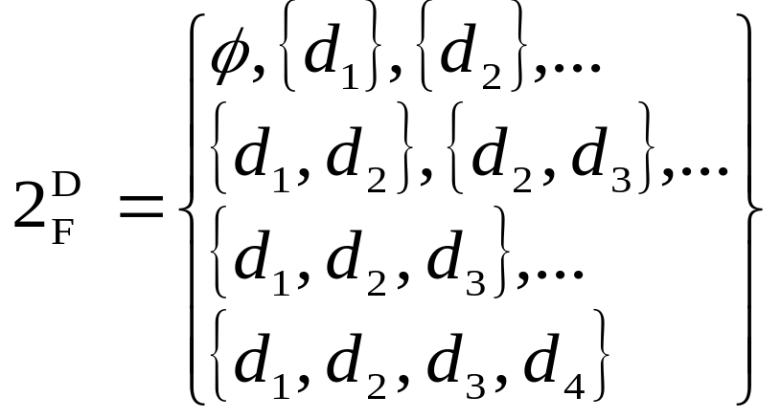
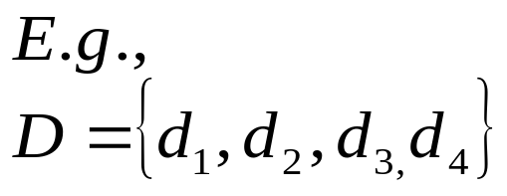
Theoretical Foundations for Testing
  test case criterion C – a subset of 2^{D}_{F},
  2^{D}_{F}: the set of all finite subsets of D
  e.g., C_{A} = { <x₁,x₂,…,x_{n}> | n ≥ 3 and
  exists i,j,k (x_{i} < 0, x_{j} = 0, x_{k} > 0) }
  “ The test set contains 3+ elements, one negative, one zero, and one positive___”
Notes:
A test selection criterion C is a subset of 2^{D}_{F}, where 2^{D}_{F} denotes the set of all finite subsets of D. In other words, C specifies a condition that must be satisfied by a test set. For instance, for a program whose domain D is the set of integers, and one zero. A test set T satisfies C if it belongs to C. In general, C may be described by a suitable formula which must be satisfied by all elements of any of the subsets of D that belong to C. For example, the aforementioned requirement of C is described by the formula C_{A} = { <x₁,x₂,…,x_{n}> | n ≥ 3 and exists i,j,k (xi < 0, xj = 0, xk > 0) }

Slide 19
Theoretical Foundations for Testing
  __consistent_ – C is consistent if, ∀T₁,T₂ ∈ C,
  T₁ is successful iff T₂ is successful
  __complete__ – C is complete if, whenever P is incorrect, ∃T₁ ∈ C → T₁ is unsuccessful
    Similar to “ideal” ⇒ “An ideal T can be produced from a complete C”
  e.g. The binary search program in Example 6.1 works properly only if the length of the sequence is a power of two.
    Let d_{i}: length of the sequence is i, then
    C₁ = { <d₅>, <d₃,d₄>, <d₇,d₈> }
    C₂ = { <d₃,d₇,d₉>, <d₂,d₄,d₈> }
Notes:
A selection criterion C is consistent if, for any pair of test sets T₁ and T₂ , both satisfying C, T₁ is successful if and only if T₂ is. Thus, if one is provided with a consistent criterion, there is no theoretical reason to make a specific choice of a test set among those satisfying C. Later we shall see, though, that there are practical reasons for preferring one test set over another.
A criterion C is complete if, whenever P is incorrect, there is an unsuccessful test set that satisfies C. Thus, were we provided with a consistent and complete criterion C, any test set T satisfying C could be used to decide P’s correctness.
For instance, suppose that P is a program to sort sequences of integers and that P works properly only if the length of the sequence to be sorted is a power of two. Then a complete and consistent criterion for P would stipulate that any test contain at least one sequence whose length is not a power of two. By contrast, a criterion which requires that either all sequences in T have a length which is a power of two or that none of them have this property is complete, but not consistent.
C1 is consistent and complete
C2 is complete, not consistent
For consistent, but not complete? {<d2, d4, d8>, <d4, d16>}

Slide 20
Theoretical Foundations for Testing
  __finer_ – C₁ is finer than C₂ if, for any P,
  ∀T₁∈ C₁, ∃T₂ ⊆ T₁ → T₂ ∈ C₂ ∧
  ∀T₂∈ C₂, ∃T₁ ⊇ T₂ → T₁ ∈ C₁ ∧ C₁ ≠ C₂
    ____Any test set in C1 includes a test set in C2, and any test set in C2 is a subset of a test set in C1, and C1 =/= C2___
    e.g.
    C_{B} = {<x₁,x₂, …, x_{n}> | n ≥ 2 and exists i,j
    (x_{i} < 0, x_{j} ≥ 0) }
    C_{A} is finer than C_{B}
Notes:
We also say that a testing criterion C₁ is finer than C₂ if, for any program P, for every test set T₁ satisfying C₁, there exists a subset of T₁, say T₂, that satisfies C_{2.}, and vice versa. For instance, suppose that C₂ = {<x₁,x₂,x₃>|(x₁<0,x₂=0,x₃>0)} and that C₁ = {<x₁,x₂,…,x_{n}> | n>=3 and exists i,j,k,m,p{x_{i}<0,x_{j}=0,x_{k}>0,xm even and x_{p} odd)}
A test set satisfying C₁ is {-3,0,6} which also satisfies C₂. Another test set satisfying C₁ is {-3,0,5,8}, from which we can extract {-3,0,5} which satisfies C₂.
Unfortunately, none of the preceding definitions is effective: We cannot derive an algorithm that states whether an object – a program, a test set, or a criterion – has that desired property.
First, consider the correctness of a program P. Suppose you may formally specify the functional requirements as a first-order formula FR(d, u), having d and u as free variables, and let P(d) be the function associated with the program. Then the correctness of P may be formally stated as for all d in D, u in R {u = P(d) implies FR (d, u)}. This statement, however, cannot be decided, since doing so would mean that we would have to decide the truth of any first-order formula – an undecidable problem. Second, in some cases, it might even be impossible to decide whether a value d is in a test set T, depending on how T is defined – another well-known undecidable problem. Thus it is impossible to decide whether a test is ideal whether a criterion is consistent or complete, etc. These are in the long list of major program properties such as correctness, termination, and equivalence that are undecidable.
Furthermore, we shall see next that many criteria used in practice are themselves undecidable; that is it is not decidable whether a given test set satisfies them or even whether there exists a test set that satisfies them. As always with undecidable problems, this means that full mechanization is not possible, and our approach to verification must be based on common sense and ingenuity. In practice, mechanical support tools can provide clerical help, but they require human interaction at some critical points.

Slide 21
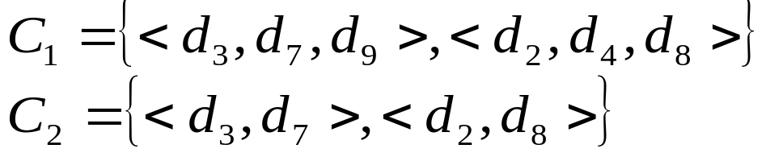
Theoretical Foundations for Testing
  __more trustable__ – C₁ is more trustable than C₂ if P is incorrect then ~ (∃ T₂ ∈ C₂ → T₂ is unsuccessful on P and ∃ T₁ ∈ C₁ → T₁ successful on P)
    If C₁ is more trustable than C₂, then C₂ cannot have a test set which is unsuccessful while C₁ has a test set which is successful
    Q: if C₁ is finer than C₂ then C₁ is more trustable than C₂?
      A: ___No!___. E.g.,
Notes:
We define a term called “more trustable” is this slide. The original term used was “more reliable” but it was confusing, so we changed the term to be “more trustable”.
If C₁ is more trustable than C₂, then C₂ cannot have a test set which is unsuccessful while C₁ has a test set which is successful.
if C₁ is finer than C₂ then C₁ is more trustable than C₂? The answer is no. An example is given.

Slide 22
Empirical Testing Principles
Exhaustive testing is impossible; we need testing strategies to select _significant_ test cases with high potential to uncover error
Increasing the number of test cases _does not_ necessarily increase the significance
  e.g., if x > y then
  max := x;
  else
  max := y; → error: y becomes another symbol
  endif;
  T₁: { (3,2), (2,3) } uncovers the error
  T₂: { (3,2), (4,3), (5,1) } does not
Notes:
In general, the only testing of any system that can provide absolute certainty about the correctness of system behavior is exhaustive-testing – that is, testing the system under all possible circumstances. Unfortunately, such testing can never be performed in practice. Thus, we need testing strategies – some criteria for selecting significant test cases. The notion of the significance of a test set, however, cannot be formalized, but it is an important intuitive notion, being an empirical approximation of the concept of an ideal test set.
A significant test case is a test case that has a high potential for uncovering the presence of an error. Thus, the successful execution of a significant test case in creases our confidence in the correctness of a program. Intuitively, rather than running a large number of test cases, our goal in testing should be to run a sufficient number of significant test cases. If a significant test set T₁ is a superset of another significant test set T₂, we can certainly rely more on T₁ than on T₂. On the other hand, since testing is costly, we must limit the number of possible experiments.
The sample in this slice shows that the number of test cases in a test set does not necessarily contribute to the significance of the set. Suppose you have written the following wrong program fragment to compute the greater of two numbers as shown in the slice. In this case, the test set {x=3,y=2;x=2,y=3} is able to detect the error, whereas {x=3,y=2;x=4,y=3;x=5,y=1} is not, although it contains more test cases.

Slide 23
Empirical Testing Principles
Group the input domain into classes, such that elements of a given class behave the same way
  One test case → __whole class__
___Complete coverage principle___: D = ∪D_{I} are those classes, where D is the input domain
D4
D
D1
…
D2
D3
Notes:
In spite of the theoretical limitations emphasized in the previous part, testing criteria are needed in practice to define significant test sets. A testing criterion attempts to group elements of the input domain into classes such that the elements of a given class are expected to behave in exactly the same way. That way, we can choose a single test case as representative of each class. If the classes D_{i} are such that ⋃D_{i} = D, we say that the testing criterion satisfies the complete coverage principle. We will see that many well-known practical testing criteria satisfy this principle.
Suppose you have to build a program to computer the factorial of any number. The specification of the program reads as follows:
If the input value n is < 0, then an appropriate error message must be printed. If 0 <= n < 20, then the exact value of n! must be printed. If 20 <= n <= 200, then an approximate value of n! must be printed in floating-point format (e.g., using some approximate method of numerical calculus). The admissible error is 0.1% of the exact value. Finally, if n > 200, the input can be rejected by printing an appropriate error message.
In this case, it is quite natural to divide the input domain into the classes { n < 0 }, {0 <= n < 20}, {20 <= n <= 200}, and {n > 200} and to use test sets containing one element from each class. Suppose that the results are correct for the data belonging to one test set (e.g., {-10,5,175}). Then the assertion that the program will behave correctly for any other value is just a reasonable expectation, not the truth!

Slide 24
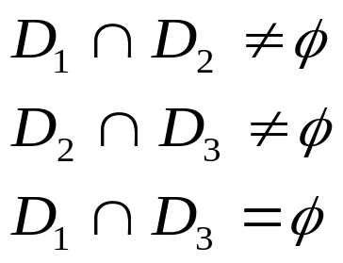
Empirical Testing Principles
To satisfy this principle:
  If D_{i} are disjoint classes, i.e., D_{i} ∩ D_{j} = φ, i≠j, we choose one test case from each D_{i}
  If D_{i} ∩ D_{j} ≠ φ, a test case in D_{i} ∩ D_{j} exercises both D_{i} and D_{j}
  e.g., D₁ = { d_{i} | d_{i} mod 2 = 0}even numbers
  D₂ = { d_{i} | d_{i} < 0} negative numbers
  D₃ = { d_{i} | d_{i} mod 2 ≠ 0}odd numbers
_D1____D3_____D2_______D1_____ D2, D3_
Notes:
If we divide the input domain into disjoint classes D_{i} such that D_{i} ⋂ D_{j} = ⌀ for i ≠ j (i.e., if the classes constitute a partition of D), then there is no particular reason to choose one element over another as representative of a class. The classes of the example give above are an example of a partition. If the classes are not disjoint, however, we have the possibility of choosing representatives to minimize the number of test cases. For example, if D_{i} ⋂ D_{j} = ⌀, a test case in D_{i} ⋂ D_{j} exercises both D_{i} and D_{j}.
For instance, consider the following testing criterion: The program must be tested with classes D₁, D₂, and D₃ of values for x, where: D₁ = {d_{i} | d_{i} mod 2 = 0}, D₂ = {d_{i} | d_{i} <= 0}, D₃ = {d_{i} | d_{i} mod 2 ≠ 0}. Here, since D₁ ⋂ D₂ = ⌀ and D₂ ⋂ D₃ = ⌀, we can choose just two test cases to exercise the program and still satisfy the complete-coverage principle. For instance, the test set {x=48; x=-37} would be acceptable.
The complete-coverage principle is subject to many interpretations, including several trivial ones. At one extreme, we could insist that each class consist of a single element; this would lead to exhaustive testing, which we have already ruled out as infeasible. At the other extreme, we could group all input data into just one class, which would lead to trying the system in just one case. Thus, we may evaluate the goodness of a testing criterion on the basis of how significant the representatives of the classes obtained by its decomposition are. The application of the principle to produce significant tests is quite a challenging task.
Ideally, the complete-coverage principle should help approximate consistent and complete criteria in the following way: If the input domain D is decomposed into several subsets D_{i}, then a test set may be chosen that contains at least one representative from each D_{i}, with the goal that if a test set T₁ differs from T₂ only with respect to which representative is chosen from each set D_{i}, then the results of test sets T₁ and T₂ are equivalent (in terms of failure or success). In such a case, the partition would provide a consistent criterion. On the other hand, completeness would be achieved if, in case the program contains an error, there is at least one D_{i} such that any representative of D_{i} exposes the error. Although we know from the previous part that, in general, it is impossible to find such a decomposition in an automatic way, common sense and insight can help in finding subsets that exhibit some degree of consistency and completeness.

Slide 25
Empirical Testing Principles
The complete coverage principle helps approximate __consistent__ and __complete__ criteria.
Notes:
In example of page 6-22, any test set that causes the execution of both branches of the if-then-else statement would most likely show the error in the program fragment, no matter which data are selected from the classes {x>y} and {x<=y}. As an exercise, the reader is invited to find the exceptions.
Thus, a careful selection of test cases, with the goal of satisfying the complete coverage principle, can in some sense approximate consistent and complete criteria. We can increase the reliability of such criteria by choosing more than one element from each class. For example, if we feel that a particular partition is “rather” consistent and complete, but that there could be some exceptions, we could improve that method by generating several cases – perhaps randomly – from the same class.
It turns out that this general principle can be applied in many different – and sometimes complementary – ways.

Slide 26
Empirical Testing Approaches
Testing in the Small vs. Testing in the Large
Testing in the small: testing individual software components
Testing in the large: decomposing and organizing the testing activity according to the __overall__ structure of complex programs.
Notes:
Next, we review how the testing activity can be organized in practice and how we can describe various empirical approaches to the determination of significant test sets in light of the complete-coverage principle. We do so by first distinguishing between testing in the small and testing in the large. Testing in the small addresses the issue of testing individual software components. Testing in the large, by contrast, addresses the issue of decomposing and organizing the testing activity according to the modular structure of complex programs.
6-<number>

Slide 27
Testing in the Small
black-box testing
  _requirements based_
  derive test cases purely based on the spec
    spec-based test case development
  test what the program is supposed to do (for all _intended__ functions)
white-box testing
  _structure based_
    look at the program structure during testing
  using information about the internal structure to derive test cases
    structure-based test case development
  test what the program does (any unintended functions?)
Notes:
Testing in the small addresses the testing of individual modules. There are two main approaches: white-box testing and black-box testing. Testing a piece of software as a black box means operating the software without relying on any knowledge of the way it has been designed and coded. Test sets are developed and their results evaluated solely on the basis of the specification. By contrast, testing software as a white box means using information about the internal structure of the software and perhaps even ignoring its specification.
Intuitively, both strategies are useful and somewhat complementary. White-box testing tests what the program does, while black0box testing tests what it is supposed to do. For this reason, we may refer to black-box testing as specification0based testing and to white-box testing as implementation-based testing. Thus, they can both increase our level of confidence in the reliability of the component. Next we describe that two approaches in some detail.

Slide 28
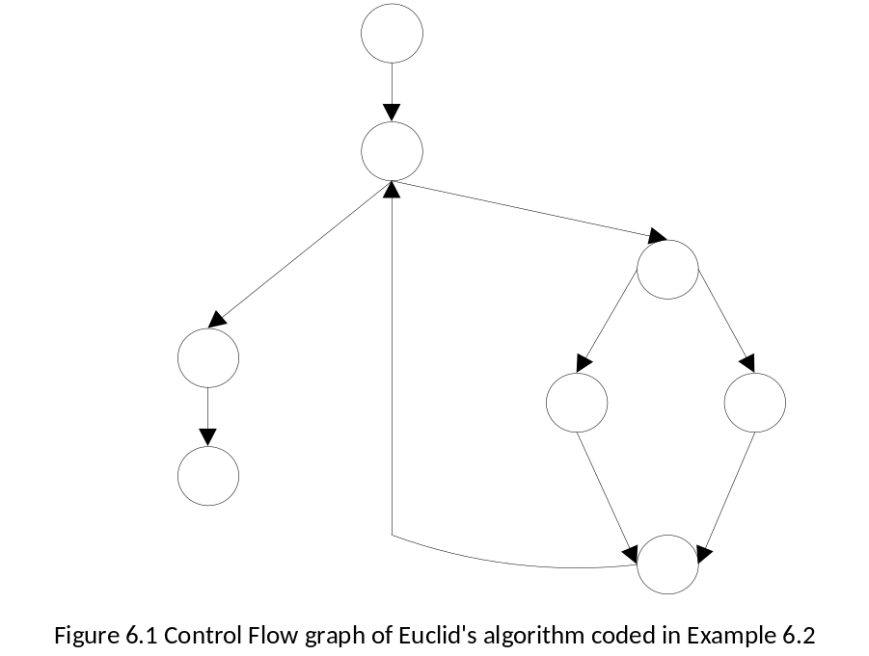
White-Box Testing
Four test selection criteria (C₀,C₁,C₂,C₃)
  Example 6.2: Consider the well-known algorithm of Euclid
  begin
  read(x);
  read(y);
  while x ≠ y loop
  if x > y then
  x := x – y;
  else
  y := y – x;
  endif;
  end loop;
  return(x);
  end;
  Select test cases { <x=3,y=3>, <x=4,y=3>, <x=3, y=4> }
  => statement coverage criterion
entry
while
x≠y
if x > y
x=y
exit
Notes:
White-box testing is also called structural testing, because it uses the internal structure of the program to derive the test data. Example 6.2 illustrates the concept. The first and simplest white-box testing strategy suggests that we should try to ensure that our test cases exercise all program statements at least once. This is called the statement-coverage criterion and is discussed next.
Consider the well-known algorithm of Euclid as shown in the slice. This program contains a sequence of statements. We want to ensure that all of the statements are executed. First, we need to ensure that the while loop is executed at least once. Then, inside the loop, we need to ensure that both the statement x := x – y; and the statement y := y – x; are executed. A possible test set that exercises all the statements in the program is {<x=3,y=3>, <x=4, y=3>, <x=3,y=4>}.
What does this problem do? To find the greatest common divisor (G.C.D.)

Slide 29
C0: Statement-Coverage Criterion
Select a test set T such that every elementary statement in P is executed at least once by some d in T
  an input datum executes many statements
  try to minimize the number of test cases while still preserving the desired coverage
Notes:
Intuitively, the statement-coverage criterion is based on the observation that an error cannot be discovered if the parts of the program containing the error and generating the failure are not executed; thus, we should strive for complete coverage of statements.
In block-structured languages, where statements may be part of more complex statements, we must be precise about what we mean by a statement. A natural assumptions is to refer to the BNF syntactic definition of programming languages and to assume as an elementary statement any statement that is derived from the <statement> non-terminal without producing any recursive occurrence of the same nonterminal,. Thus, in a conventional block-structured language, assignment statements, I/O statements, and procedure calls are elementary statements. With this assumption, the criterion can be stated as follows.
STATEMENT-COVERAGE CRITERION: Select a test set T such that, by executing P for each d in T, each elementary statement of P is executed at least once.

Slide 30
Example
read (x); read (y);
if x > 0 then
write ("1");
else
write ("2");
end if;
if y > 0 then
write ("3");
else
write ("4");
end if;
{<x = 2, y = 3>, <x = - 13, y = 51>,
<x = 97, y = 17>, <x = - 1, y = - 1>}
covers all statements
{<x = - 13, y = 51>, <x = 2, y = - 3>}
is minimal (two test cases)
Notes:
In general, the same input datum causes the execution of many statements. Thus, we are left with the problem of trying to minimize the number of test cases while still ensuring the execution of all statements. For instance, consider the program fragment in this slice.
Left us denote by I₁,I₂,W₁,W₂,W₃, and W₄, the first and second if statements and the write (“1”), write(“2”), write(“3”), and write(“4”), statements, respectively. Also, let D_{i} denote the class of input values that cause execution of Wi, for i=1,…,4. Clearly, D₁ = {x>0}, D₂ = {x<=0}, D₃ = {y>0}, and D₄ = {y<=0}. Thus, if a representative is chosen from each of the classes, we are guaranteed that all of W₁, W₂,W₃, and W₄ are executed at least once.
Therefore, we might choose the following test set: {<x=2,y=3},<x=-13,y=51>,<x=97,y=17>,<x=-1,y=-1>}. This test set, however, is not minimal with respect to the criterion, since every input datum belongs to two classes. Thus, we many reduce the number of test cases to two, for example, by selecting the following representatives: {<x=-13,y=51>,<x=2,y=-3>}

Slide 31
Weakness of the Criterion
if x ≠ 0 then
x := -x;
end if;
z := 1.0/x;
{x=3} covers all
statements
it does not exercise the
case when x is __0___
where the __”then”__ branch is not entered
Notes:
A weakness of the statement-coverage criterion is illustrated by the fragment in the slice. Choosing a test set such that, at the beginning of execution of the fragment, x is negative, would result in the execution of all statements of the fragment. Not exercising the case x>=0, however, is in some sense a lack of completeness. In fact, we could see the fragment as a short notation for:
If x≠0 then
x:=-x;
Else
Null;
Else if;
z:= 1.0/x;
In this formulation, the statement-coverage criterion would require executing even the null statement, and the experiment could show an error. Thus, different syntactic conventions could lead to different instantiations of the same criterion. We shall deal with this problem later.

Slide 32
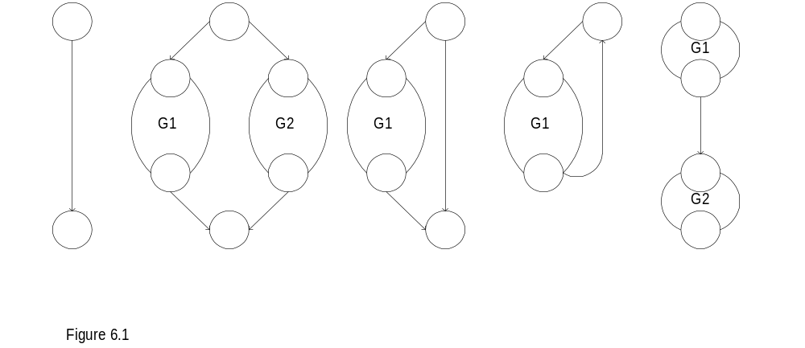
Control Flow Graph G_{p} for Program P
a) entry
b) if-then else
c) if
d) repeat /while
e) sequence
Figure 6.2 Construction of the control-flow graph of a program
Notes:
The complete-coverage principle may also be applied to criteria on the basis of the program structure, described by a graphical representation of the program control flow. Assume again the case of a simple block-structured language.
For any program fragment P, its control flow graph G_{p} is built inductively in the following way.
1. For each I/O, assignment, or procedure call statement, a graph of the type of Figure 6.2 (entry). The graph has the edge, representing the statement. The edge connects two nodes that represent entry into, and exit from, the statement. If needed, a unique label, labeling both the statement and the edge of the graph, may be used to make the correspondence between edges and statements explicit.
2. Let S₁ and S₂ denote two statements and G₁ and G₂ denote their corresponding graphs. Then, the corresponding explanations of the figures in this slice are shown in the next slice.

Slide 33
Control Flow Graph G_{p} for Program P
I/O procedural call
if cond then S1; → _____G1____
else S2; → _____G2_____
endif;
if cond then S1;
while cond loop
S1;
endloop;
S1;
S2;
- Sequential nodes may be considered as only one node to simplify the control flow graph
Notes:
The statement (a-e) are associated with the previous five figures respectively.
I/O procedural call
if cond then S1;
else S2;
endif;
if cond then S1;
while cond loop
S1;
Endloop;
S1;
S2;
Sequential nodes may be considered as only one node to simplify the control flow graph

Slide 34
Control Flow Graph G_{p} for Program P
__Node___ (circle) – one or more procedural statements (sequential statements can be lumped together)
___Edge___ (arrow) – flow of control
__Regions___ – area bounded by edges and nodes (include the area outside the graph)
_Predicate__ node – the node which contains a conditional statement
Notes:
This slide shows the associated terminology regarding the representation of Control Flow Graph G_{p} for Program P,.
Definitions of nodes, edges, regions, and predicate nodes are given.

Slide 35
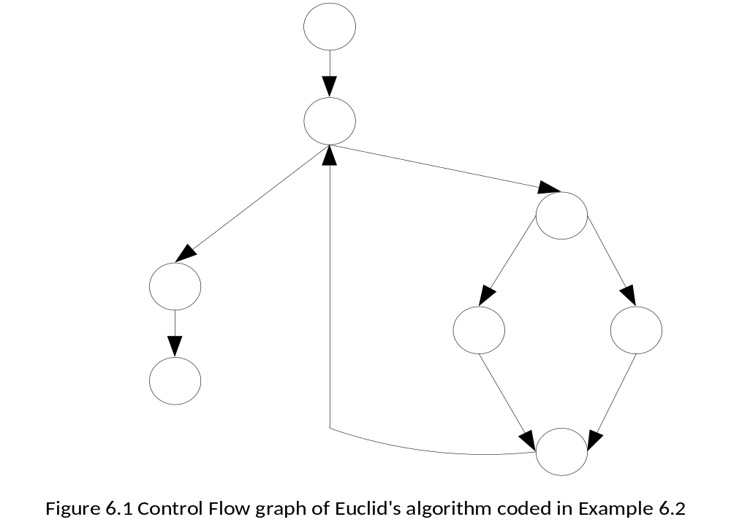
Control Flow Graph G_{p} for Program P
entry
# nodes:______9_______
# edges:______10______
# predicate nodes: __2___
# regions:____3_______
_e-n+2___
= _10-9+2______
= _3__
= V(G)
= R
while
x≠y
if x > y
x=y
exit
Notes:
An example of showing Control Flow graph of Euclid’s algorithm coded in a previous example.
The numbers of nodes, edges, predicates, and regions can be calculated correspondingly.

Slide 36
McCabe’s Theory
McCabe’s cyclomatic complexity V(G)
1) V(G) = e – n + 2
  Where in the control flow graph
    e: number of edges
    n: number of nodes
    V(G): the number of linearly independent paths in a program (the number of conditions plus one, if no GOTOs)
    for each module V(G): __3-7__ good structure upper bound ____10_____
2) V(G) = # of regions (R)
3) V(G) = # of predicate nodes + 1
Notes:
Another source-code metric was developed by McCabe, who observed that the quality of a program depends on the complexity of its control flow, rather than on operators and operands. McCabe’s complexity metric V(G) is based on the control flow graph and is defined as
V(G) = e – n + 2
Where e is the number of edges, and n is the number of nodes.
In graph-theoretic terms, V(G) is called the cyclomatic number of the graph, and thus McCabe’s metric is called cyclomatic complexity. V(G) defines the number of linearly independent paths in a program. Note a linearly independent path is any path through the program that introduces at least one new edge that is not included in any other linearly independent paths. It is possible to prove that, for structured programs with single-entry, single-exit constructs (i.e., with no goto statements), the cyclomatic number is equal to the number of conditions plus one. Also, for planar graphs, it is equal to the number of regions into which the graph divides the plane. For example, in the case of Euclid’s algorithm, whose control flow graph is shown in Figure 6.1, the cyclomatic complexity is 3.
According to McCabe, the number of conditions that govern the control flow is an indication of how difficult the component is to understand, test, and maintain. McCabe also contends that well-structured modules have a cyclomatic complexity in the range from 3 to 7, and C = 10 is a reasonable upper limit for the complexity of a single module, as is confirmed by empirical evidence.

Slide 37
C₁: Edge Coverage Criterion
Select a test set T such that, by executing P for each d in T, each edge of P’s control flow graph is traversed at least once
  A _linearly independent_ path: Any path through the program that introduces a new edge coverage that is not included in any other linearly independent _____ path.
Note: problem may arise for compound Boolean expressions, e.g. (if C₁ and C₂ or C₃ ….), where Ci’s, “constituents”, not all tested
Notes:
EDGE-COVERAGE CRITERION: Select a test set T such that, by executing P for each d in T, each edge of P’s control flow graph is traversed at least once.
We can see that the test sets derived by the edge-coverage criterion exercise all conditions that govern that control flow of the program, in the sense that the criterion requires test cases which makes each condition generate both true and false values (at different times, of course). You can prove that, in general, the edge-coverage criterion produces different results from, and is finer than, the statement-coverage criterion. As an exercise, you should also verify that the test we derived for Euclid’s algorithm actually provides edge coverage.

Slide 38
C₁: Edge Coverage Criterion
Example 6.3:
found := false;
if number_of_items ≠ 0 then counter := 1;
while (not found) and counter ≤ number_of_items loop
if table(counter)= desired_element then
found := true;
endif;
counter := counter + 1;
endloop;
endif;
if found then write
(“the desired element exists.”);
else write(“the desired
element does not exist.”);
endif;
Searching an element
  # items = 0________________
  3 items in the list, 2nd is the one to be found; e.g. [5, 10, 4], 10 to be found satisfy C1, but can’t find the defect________________________
  To detect the error, use same case as 2, but 3rd (e.g. “4”) is the one to be found
Notes:
The edge-coverage criterion can be further strengthened to make it more likely to expose errors. Consider the fragment in this slice, which searches for an element within a table (implemented as an array of items).
This code contains a trivial and common error: “<“ appears instead of “<=“ in the loop condition. Let us choose the following test sets:
1. A table with no items (i.e., number_of_items = 0); this causes execution of the fragment without any iteration of the body of the loop.
2. A table with three items, the second being the desired one; this causes execution of the body of the loop twice, the first time without executing the then branch, the second time executing it. Notice that both branches of the final if-then-else statement are executed, so that the edge-coverage criterion is fulfilled.
The error is not discovered by the test set. Closer inspection of the program shows that the loop condition has two parts: “not found” and “counter < number_of_items”. The two test cases we provided exercised the two possible values of the first part (one for each iteration), but only one of the possible outcomes of the second. A stricter criterion, requiring that both possible values of the second constituent of the condition be exercised, would have revealed the error.
In general, a compound Boolean expression may be true or false, depending on the values of its constituent expressions. For example, if C is a compound Boolean expression written as the conjunction or disjunction of several elementary clauses (i.e., C is of the type C1 and C2 or C3…, with Ci being either an atomic formula or its negation), then these atomic formulas are called constituents, and their values affect the value of C. Often, as in the example, the different values taken by each individual constituent expression characterize significant test cases.
We can thus derive a new testing criterion that is finer than the edge-coverage criterion in next slice.
For this bug, what test case will fail the program? Ans: the element to be found is the last in the table.

Slide 39
C₂: Condition Coverage Criterion
Select a test set T such that each edge of P’s control flow graph is traversed, and all possible values of the constituents of compound conditions are exercised at least once.
Q: If a compound condition includes n constituents, how many test cases are needed?
A: 2^n
Notes:
CONDITION-COVERAGE CRITERION: Select a test set T such that, by executing P for each element in T, each edge of P’s control flow graph is traversed, and all possible values of the constituents of compound conditions are exercised at least once.

Slide 40
C₂: Condition Coverage Criterion
if C₁ then
if C₂ then
S₁;
else
S₂;
endif
else
S₂;
endif
if C₁ and C₂ then
S₁;
else
S₂;
Notes:
Another way of looking at this situation is to observe that a statement such as the left statement in this slice, which is equivalent to the one on the right. If one applies the edge-coverage criterion to the second form, one actually generates test sets that exercise all edges of the control flow graph and all possible values of atomic conditions. Thus, the condition-coverage criterion enhances the edge-coverage criterion by making explicit the edges that might be “hidden” in the control flow graph of the program.

Slide 41
C₂: Condition Coverage Criterion
if C₁ and C₂ and C₃ then
S₁;
else
S₂;
if C₁ then
if C₂ then
if C₃ then
S₁; 1st
else
S₂; 2nd
endif
else
S₂; 3rd
endif
else
S₂; 4th
endif
C₁ | C₂ | C₃
T | T | T | 1st
T | T | F | 2nd
T | F | T | 3rd
T | F | F | 3rd
F | T | T | 4th
F | T | F | 4th
F | F | T | 4th
F | F | F | 4th
Q: For n constituents, how many test cases are needed now?
A: n+1
Notes:
This slide extends a compound condition to involve three constituents. The conversion procedure from the compound condition to an equivalent form of simple condition is the same. Edge coverage criterion can then be applied.

Slide 42
C₂: Condition Coverage Criterion
Note: C₁ and C₂ can still fail for significant test cases
  if x ≠ 0 then
  y := 5;
  else
  z := z – x;
  endif;
  if z > 1 then
  z := z / x;
  else
  z := 0;
  endif;
  test 1: {<x=0,z=1>;<x=1,z=3>}
  test 2: {<x=0,z=3>;<x=1,z=1>}
x=0
x≠0
x=0
x≠0
z>1
z≤1
z>1
z≤1
Notes:
Path Coverage: The next example shows that the edge-coverage criterion may fail to identify significant test cases.
In the program fragment, the test set {<x=0,z=1>,<x=1,z=3>} causes the execution of all edges, but fails to expose the risk of a division by zero. Such a risk would be uncovered by the test set {<x=0,z=3>,<x=1,z=1>}, which would exercise other possible flows of control through the fragment.

Slide 43
C₃: Path Coverage Criterion
Select a test set T such that all paths leading from the initial to the final node of P’s control flow graph are traversed at least once
  In general, the number of possible execution paths in a program is __very large__
  e.g., 10 simple if statements (with simple conditions) => 2^10 paths!
  Problem: The # of paths can be very large.
  Main complexity: program constructs which make paths approaching infinite => ____loops (nested loops)___
  a practical solution: look for conditions that execute loops
    __zero or minimal__ times
    a _maximal_ number of times
    an _average_ number of times
Notes:
PATH-COVERAGE CRITERION: Select a test set T such that, by executing P for each d in T, all paths leading from the initial to the final node of P’s control flow graph are traversed.
Clearly, this new criterion is finer than the edge-coverage criterion. In the example in previous slice, the path consisting of the else-then branches of the two if statements would have shown the error.
Unfortunately, in the general case, the number of possible execution paths, even in simple programs, is very large – too large, in practice, if not infinite. Traversing all control paths is almost as infeasible as exercising all possible input data. Thus, the path-coverage criterion turns out to be impractical in almost all cases.
The criterion, however, can be kept as a “reference guide” in order to determine a few critical paths, among the many possible ones, to be exercised. For instance, going back to the earlier program fragment that searches for an element within a table, we see that there is some intuitive evidence that an important sample of execution paths could be the following:
Skipping the loop (the table is empty);
Executing the loop once or twice and then finding the desired element;
Searching the entire table without finding the desired element.
More generally, we could suggest the following empirical guideline for testing loops: Look for conditions that execute loops
1. zero time (or a minimum number of times in special cases, such as repeat until loops);
2. a maximum number of times;
3. an average number of times ( according to some statistical criterion).
Furthermore, when dealing with complex combinations of alternatives (several if or case statements), one should try to combine paths as much as possible. The major source of complexity is nested loops.

Slide 44
C₃: Path Coverage Criterion
Important points about testing
Even for C₀, could we enforce the testing policy that “100% of statement coverage must be achieved”?
No, because of unreachable statements
e.g. if x > 0 then
if x < 0 then
S1;
Notes:
The example shown in the slice shows that coverage of all statements in a program may be impossible if the program contains unreachable statements.

Slide 45
C₃: Path Coverage Criterion
How about “100% of reachable statements being covered?”
⇒ It is still very difficult because hard to enforce certain conditions
e.g. read(x);
z := 2 × x;
if z = 4 then S₁;
It is not decidable whether suitable input data exist that guarantee the execution of a statement (_test case generation_ problem)
Notes:
After we have chosen a coverage criterion (say, statement coverage or edge coverage), we get to the point of determining actual input values that would fulfill the criterion. For instance, consider the following fragment, and suppose we are trying to follow the statement coverage criterion:
read(x);
z := 2*x;
if z = 4 then
statement…
Here it is obvious that if we want to execute the statement, we need to supply the value 2 to the read statement. In the following fragment, however, there is no input value that will cause the execution of statement.
Of course, one may still reformulate the criterion by requiring that all reachable statements be covered at least once by test data. In the general case, however, it is not decidable whether suitable input data exist that guarantee the execution of some given statement in a given program (i.e., whether some given statement is reachable). Consequently, the criterion is not effective.
Consequently, if we try to enforce the testing policy that “100% of statement coverage must be achieved”, not only may the goal be unachievable, but also, we cannot decide algorithmically whether the 100% coverage was not reached because we were unable (or too lazy) to find test cases or because of the presence of unreachable statements.
This is yet another case where the theory of testing reveals unsolvable problems: Whatever coverage criterion we try to fulfill, we face problems that cannot be solved in a purely mechanical fashion, but rather require human intervention at some point.

Slide 46
Other Coverage Criteria
Data Flow Coverage Testing Criteria
Def-Use: _Define-Use_ pair coverage
Including C-Use (_Computation_ Use) and P-Use (_Predicate_ Use)
a: integer;
a := 4; _Define of a__
…
if (a > 0) then _P-Use of a_
b := a + 10; _C-Use of a_
Notes:
This slice introduces the data flow coverage, which includes Def-Use (Define-Use) pair coverage.
Data flow through a program via variables. Programmers define variables, and then use them. We therefore can calculate how many pairs of define-use are there in a program.
During testing, we measure how many of the Def-Use pairs are covered, in terms of percentages. Ideally, testing should cover all these Def-Use pairs. This is the main idea of data flow coverage measures.
A variable is defined by given its type, and assigned with a value (i.e., occurring in left-hand side of an assignment)
There are two ways a variable can be used: it is either used in a computation (i.e., occurring in right-hand side of an assignment), or used in a predicate. The former is called C-use, while the latter is called P-use.

Slide 47
Commission vs Omission Errors
Commission error: doing something _wrong__
Omission error: failing to do the _right_ thing
Commission errors Omission errors
“wrong” or “extra” “missing”
“false positive” “false negative”
Q1: Which error cannot be addressed by white-box testing?
A1: Omission errors
Q2: What needs to be considered additionally for omission errors
A2: Specification
Notes:
An act of commission (doing something wrong) or omission (failing to do the right thing) that leads to an undesirable outcome.
Commission errors include doing things which are not needed, or those producing wrong results.
Omission errors include missing to do the needed things correctly.
Errors of commission are sometimes also called "false positives." They refer to instances in which someone or something is erroneously included for consideration when it should have been excluded, or doing it incorrectly.
Errors of omission are also sometimes called "false negatives." They refer to instances in which someone or something is erroneously excluded from consideration when it should have been correctly included.
Finally, we mention that structural or white-box testing can catch only errors of “commission” but not errors of “omission.” That is , if the code omits the implementation of some part of the requirements specification, the test cases derived from the code will also ignore that part of the requirements specification. Test cases derived from requirements specifications, on the other hand, can handle such errors of omission.
6-<number>

Slide 48
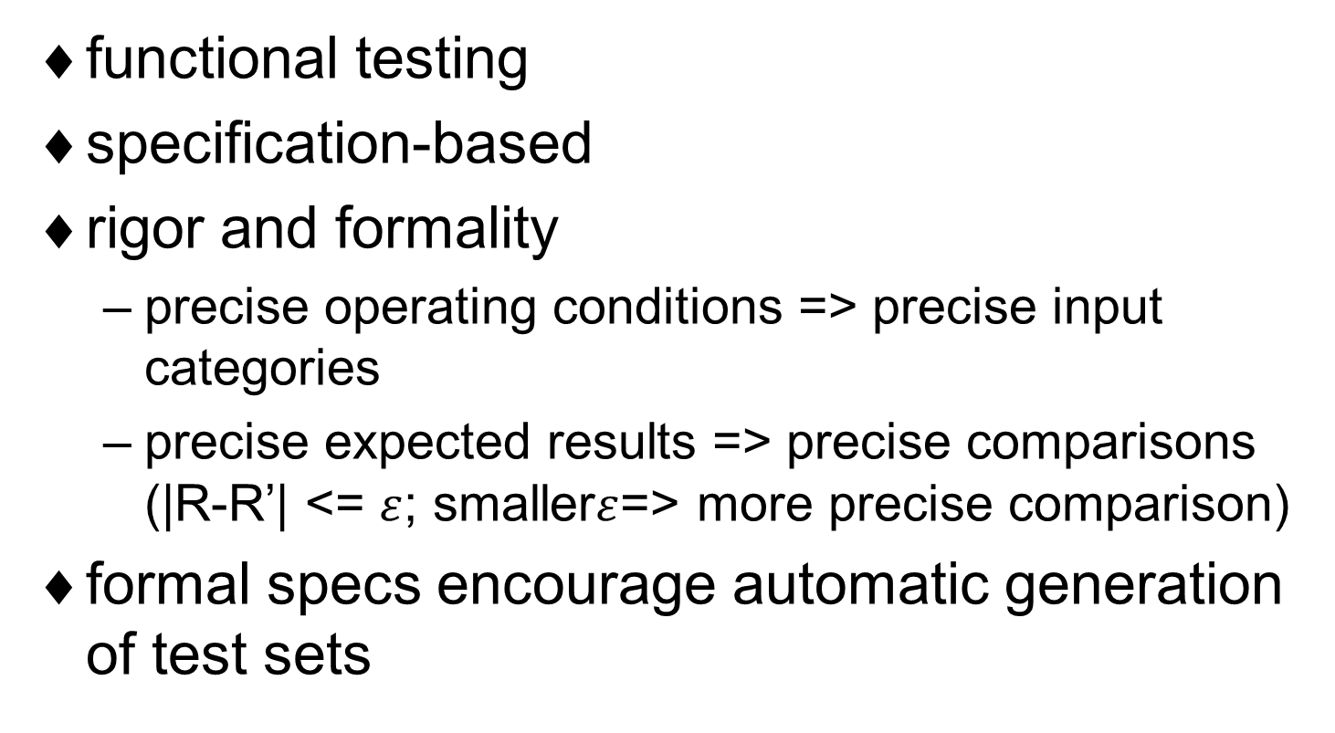
Black-Box Testing
Notes:
Black-box testing, also called functional testing, is based on the definition of what a (piece of) program is intended to do (i.e., it is based on the program’s specification, rather than on its structure). We can apply the complete-coverage principle to black-box testing. Suppose that the specification of a program reads as follows:
The program receives as input a record describing an invoice. (A detailed description of the format of the record is given.) The invoice must be inserted into a file of invoices that is sorted by date. The invoice must be inserted in the appropriate position: If other invoices exist in the file with the same date, then the invoice should be inserted after the last one. Also, some consistency checks must be performed: The program should verify whether the customer is already in a corresponding file of customers, whether the customer’s data in the two files match, etc.
The following is an intuitive way to test this program:
1. Provide an invoice whose date is the current date.
2. Provide an invoice whose date is before the current date. (In some systems, this provision could be forbidden by law, depending on the country in which the system is operated.) This case, in turn, can be split into the two following subcases:
Provide an invoice whose date is the same as that of some existing invoice.
Provide an invoice whose date does not exist in any previously recorded in voice.
3. Provide several incorrect invoices, checking different types of inconsistencies.
This informal procedure is the result of decomposing the specifications into a set of relevant classes and analyzing the behavior of the program in at least one case for each class.
Here, again, we see a major motivation for being rigorous, and possibly even formal, in writing specifications: The more precisely the operating conditions of the system and the expected results are defined, the more precisely can one categorize input data and compare the observed results against the expected ones. Furthermore, when specifications are given in a formal notation, test sets could even be derived (semi) automatically by tools that apply the very same philosophy and technique as in the case of white-box testing.

Slide 49
Black-Box Testing
Two examples (practical approaches)
  Decision table-based testing
    A spec is described by a decision table
    ⇒ provides a __tabular__ of input and expected output
  Cause-effect graphs
    Structuring complex input-output specs
    ⇒ a special case for _decision table-based testing_
Notes:
We present a couple more cases of black-box testing, perhaps more used in practice, that are suitable for more specialized application domains: decision table-based testing, which is applicable whenever a specification is described by a decision table; and the cause-effect graphs technique.

Slide 50
Decision Table-Based Testing
To generate test cases on the basis of the decision table
  Useful in __data-processing__ applications
Example 6.5
Consider the following informal specification for a word processor:
The word processor may present portions of text in three different formats: plain text (p), boldface (b), and italics (i). The following commands may be applied to each portion of text: make text plain (P), make boldface (B), make italic (I), emphasize (E), superemphasize (SE). Commands are available to dynamically set E to mean either B or I. (We denote such commands as E = B and E = I, respectively.) Similarly, SE can be dynamically set to mean either B (command SE = B), or I (command SE = I), or B and I (command SE = B+I).
Notes:
Decision tables are a simple formalism to describe how different combinations of inputs may generate different outputs. Decision tables find practical use particularly in data-processing applications. Their tabular form makes them easy to understand and supports a systematic derivation of tests. We introduce decision tables here through an example.
In the Example 6.5, the decision table corresponding to the specification is given in Table 6.1. The rows of the table describe conditions ( here, the commands given to the word processor); columns represent rules (i.e., the actions that are the result of exercising the conditions). For example, the rule represented by the leftmost column of the table shows that condition P generates output p. (To avoid cluttering the table with too many entries, we show only true conditions, marked with the letter X.)

Slide 51
Decision Table-Based Testing
P
true
B
true
true
I
true
true
E
true
true
commands (conditions/input)
SE
true
true
true
E=B
true
E=I
true
SE=B
true
SE=I
true
SE=B+I
true
Number of columns can go up to 2^{n}, where n is the number of input conditions
To reduce the # of test cases, we use cause-effect graph technique
Action
p
b
i
b
i
b
i
b,i
b,i
rules (actions/output)
Table 6.1 Decision table specifying the word processor of Example 6.5
Notes:
One can generate test cases naturally on the basis of the decision table, trying to apply the complete-coverage criterion so that each column of the table is exercised by at least one test. This “blind” application of the principle, however, may be too expensive in terms of the number experiments to be carried out, because of the exponential growth in the number of test cases with respect to the number of conditions. In fact, in general, the number of columns can go up to 2^{n} , where n is number of conditions. Thus, we may need some technique to select a significant subset of all possible input classes. A way to tackle this problem is discussed next.

Slide 52
The Cause-Effect Graph
The cause-effect graph technique
  A formal way of structuring complex input-output specifications
  Transform the spec of inputs and outputs into Boolean values
  The program is transformed into a Boolean function
Example 6.6
  Causes: {B,I,P,E,SE,E=B,E=I,SE=B,SE=I,SE=B+I}
  Boolean {f,f,f,t,f,t,f,f,f,f} => E=B and E
  Effects: {b,i,p} e.g., <t,f,f> => bold text
Notes:
The cause-effect graph technique is based on a formal way of structuring complex input-output specifications called cause-effect graphing. To apply cause-effect graphing, one must first transform the specification of inputs and outputs into Boolean values and the transformation performed by the program into a Boolean function. We describe the technique in the next example.
The sample in this slice is Example 6.6. Consider the informal specification for a word processor given in Example 6.5. An input command in {B,I,P,E,SE,E=B,E=I,SE=B,SE=I,SE=B+I} can be represented by a 10-tuple of Booleans (called causes). For example, <true, false, false, false, false, false, false, false, false, false> represents command B, and <false, false, false, true, false, true, false, false, false false> represents E = B and E. The same technique obviously applies to outputs, called effects. In our example, an output is an element in {b,I,p,}; for instance, <false, false, true> denotes a plain text output.
Once both the input and the output domains are restated in terms of Booleans representing causes and effects, the function is also restated as a Boolean function. In particular, it is synthesized as a combination of the logical operators not, and, and or and is graphically represented by using any one of the well-known techniques such as the and-or-graph. Figure 6.3 (next slice) gives a pictorial representation of how a boldface output may be obtained; the reader should complete the graph as an exercise.

Slide 53
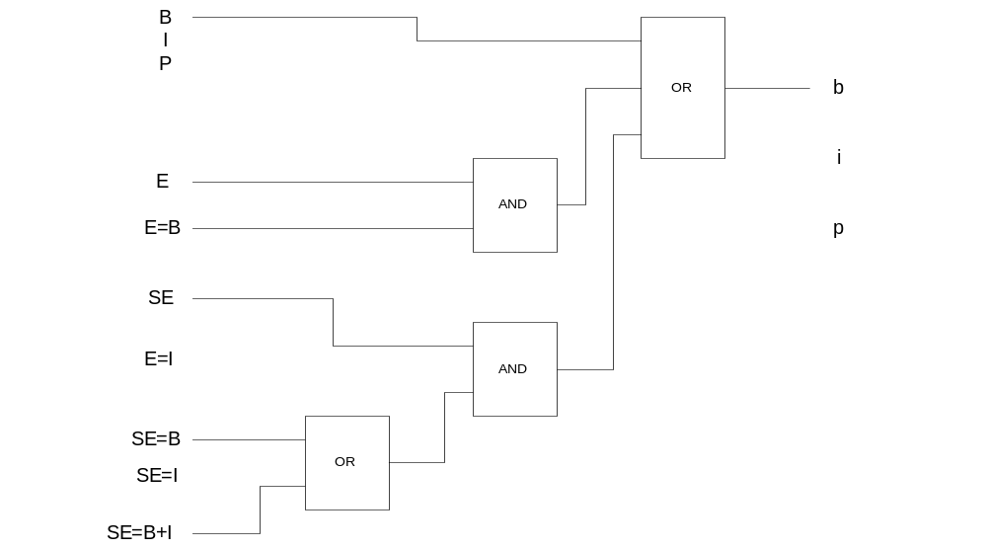
The Cause-Effect Graph
Figure 6.3 Partial and or graph for a word processor for bold-face output
Notes:
Suppose now that informal requirements also specify the following constraints: Both B and I exclude P(e.g., one cannot ask for both plain text and italics for the same portion of text). E and SE are mutually exclusive.

Slide 54
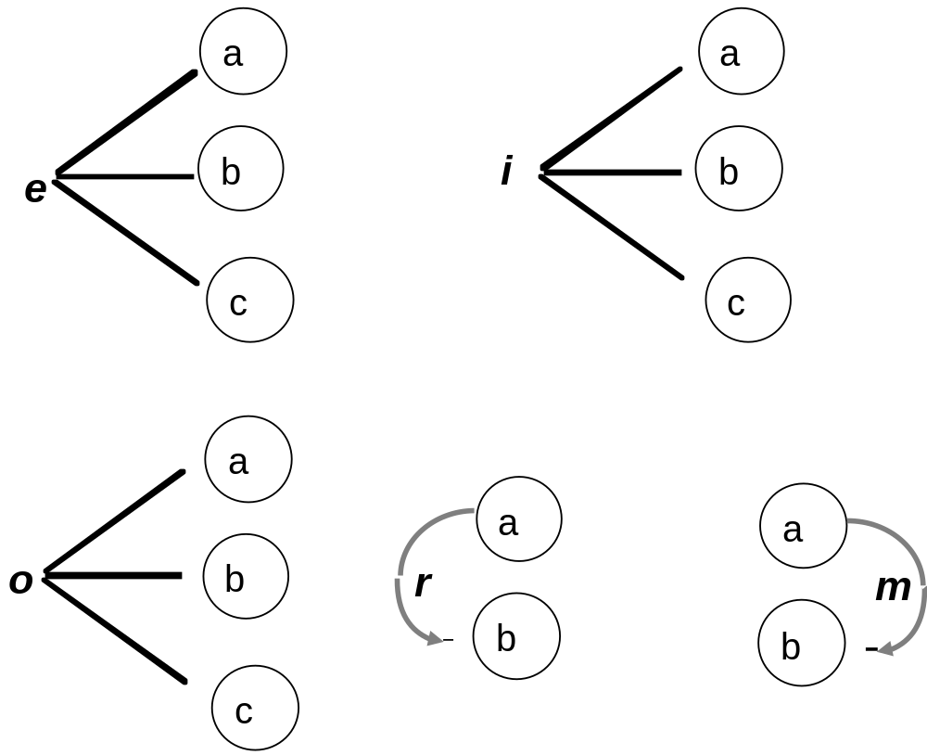
The Cause-Effect Graph
Constraints
  e: at most one
  i: at least one
  o: one and only one
  r: implies
  m: masks
Figure 6.4 Graphical representation of constraints among logical variables
Notes:
Since B and P are mutually exclusive, the tuple <true, false, true,…> would not describe valid input commands, because it would request both bold and plain text. The following notation may be used to specify constraints:
A dotted connection labeled e of the type of Figure 6.4 joining the logical variables a, b, and c states that at most one among a, b, and c may be true.
A dotted connection labeled i states that at least one of the arguments a, b, and c must be true.
A dotted connection labeled o states that one and only one of a, b, and c must be true.
A dotted directed connection from a to b labeled r states that a requires b – that is, a implies b.
A dotted directed connection from a to b labeled m states that a masks b – that is, a implies not b.

Slide 55
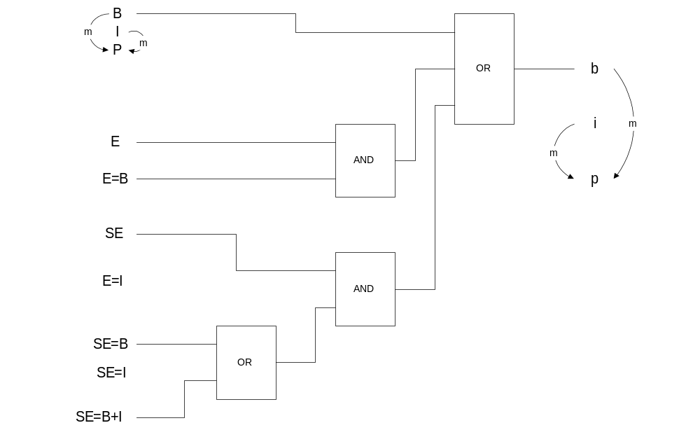
The Cause-Effect Graph
Figure 6.5 The fragment of Figure 6.3 augmented with diagram showing constraints among the variables
Notes:
Similar constraints can be imposed on output variables as well. When such constraints are specified on both inputs and outputs, their compatibility must be verified. Figure 6.5 is an enrichment of Figure 6.3 that displays all constraints on input and output variables.

Slide 56
The Cause-Effect Graph
Constraints reduce the number of valid input and output cases
For each admissible combination of output values, use heuristics to select the combination of input values (approximate the ____________________________)
  for OR whose output is true, select those with only one true input
  for AND whose output is false, select those with only one false input
Notes:
The graph that is obtained by following the procedure set out in Example 6.6 is called the cause-effect graph of a program specification. The cause-effect graph can be used to drive program verification by applying the complete-coverage principle in a fairly obvious way, namely, by generating all possible combinations of inputs and checking whether the outputs correspond to the specification. Actually, the graph can also be used to assess the specification itself. In fact, it can show an inconsistency if, say the output corresponding to an admissible input violates the graph’s compatibility constraints. Also, the graph can show incompleteness if, say, no input value is found that supplies an admissible output.
If the size of the test set is considered excessive, the following procedure can be applied to reduce the size: For each admissible combination of output values, find some combinations of input values which cause that combination of output values, by tracing back through the graph. The combinations of input values are selected among all possible ones by means of the following heuristic rules:
1. In tracing back through an or node whose output is true, we use only input combinations that have exactly one true value. This way, each cause is tried independently, assuming that combining two causes does not alter the separate effects of each. For instance, if the output of an or node must be true, and I₁, I₂ are the inputs, we consider only {<I₁ = true, I₂ = false>, <I₁ = false, I₂ = true>}.
2. Similarly, in tracing back through an and node whose output is false, we use only input combinations that have exactly one false value.

Slide 57
Boundary Conditions
Typical program errors happen at the boundary between different classes
e.g.,
if x > y then
S1;
else
S2;
endif;
Select test cases for x > y
x < y and x = y (if “ > ” becomes “ >= “)
Initial conditions
Notes:
We have based our testing criteria – both white box and black box – mostly on partitioning the input domain of the program into suitable classes, on the assumption that the behavior of the program is “similar” for all elements of each class. Some typical programming errors, however, just happen to be at the boundary between different classes.
For instance, quite often programmers use ‘<‘ instead of ‘<=‘, or conversely, This error is unlikely to be detected by applying any of the previous techniques. It is also one of the main reasons that pure random testing works poorly.
More precisely, suppose that a program fragment is of the type like shown in this slice. Many of the white-box testing criteria would lead to selecting at least one pair of values for x and y such that x > y and at least one pair such that x <= y. This could easily miss a test case with x = y, which would be the most natural way to detect the error of writing ‘>’ instead of ‘>=‘.
The preceding remark leads to a natural suggestion: After having partitioned the input domain D into several classes, test the program using input values not only “inside” the classes, but also at their boundaries. Notice that the suggestion applies to white-box techniques as well as to black-box techniques. This natural way of complementing many of the previous testing criteria is usually called testing boundary conditions.
In practice, the different testing criteria should always be applied in combination, because none is completely effective by itself.

Slide 58
Testing in the Large
The combinatorial explosion of the testing techniques in the previous sections make them applicable only to small programs
To deal with complex s/w, we need other techniques
Notes:
So far, we have been concerned with testing single pieces of software – that is, individual modules that will be combined with other modules to form a complete system. Actually, they could also be complete programs considered as a whole – programs whose testing was considered with respect to an overall definition of their expected behavior.
The combinatorial explosion of many of the techniques we illustrated in the previous sections might make them applicable only to small programs. Of course, when we are dealing with complex systems, we need techniques to master the complexity of their verification – and of their testing, in particular – just as we do for their design and specification. The current section deals with this problem.

Slide 59
Testing and Modularity
Organize the testing activity to reflect the design activity: test modules separately, one by one, and eventually test the whole system
Structure the testing into separate phases
module testing (unit testing) → integration testing (development environment)
→ system testing
(delivery environment)
operational environment
Notes:
The organization of the testing activity should in some way reflect the organization of the design activity. This implies that the modular architecture of the system is a natural candidate to drive the verification of the system. Just as we build a complex system by first designing it as a collection of related modules, we should be able to test modules separately, one by one, and eventually test the whole system on the basis of the relationships among the modules. There are several obvious benefits to be derived from testing a system modularly: It is easier to localize errors; it is easier to discover errors at early stages of their development; and it is easier to classify errors according to their scope (i.e., whether they are design errors, coding errors, etc.).
Thus, good design techniques result in better software, not only in the sense that the software is likely to contain fewer errors, but also in the sense that it is easier to catch and fix the errors that do occur. In other words, good design techniques enhance verifiability also.
We shall discuss module testing, integration testing, and system testing .Module testing is intended to verify whether a given module has been implemented correctly with respect to its expected external behavior: The module works correctly, no matter which modules are interacting with it, provided that these modules are using its interfaces correctly. System testing is intended to check whether a whole collection of modules behaves properly – possibly on the basis of the assumption that all of its constituent modules behave properly by themselves.
Systems are often integrated gradually: Collections of modules are put together to form a subsystem, and this may be progressively integrated with other modules or subsystems. Partial systems may thus be created and tested. We call the testing that is performed while a system is being integrated integration testing . At the final stage of integration that results in the whole system, integration testing coincides with system testing. In general, however, system testing is executed in the actual delivery environment ( or as close as possible to it), as opposed to the development environment, in which module testing and integration testing take place. Related to system testing is acceptance testing, which is performed by the customer, possibly together with the developer, before taking delivery of the product. Depending on the application also some levels of integration and system testing (e.g., testing an embedded application consisting of the hardware and the software running on it) are not pure software testing.

Slide 60
Module Testing in Context
Test in the small
To test a single module, a complete execution environment is required:
  The module may use an external operation (external procedure call)
  It may access non-local data structures
  It may be used by another module
if (1) is missing, build __stubs__
(2) is missing, construct temporary __shared__ data structure
(3) is missing, build __drivers__
Notes:
A single module should be tested on the basis of the techniques described as testing in the small. A module, however, often cannot be executed by itself. Using the terminology of Topic 5, if M_{i} USES M_{h} and M_{i} USES M_{k}, then the correct execution of M_{i} requires the availability of correct versions of M_{h} and M_{k}, If we wish to execute M_{i} in isolation (e.g., because M_{h} and M_{k} are not yet available), then we need to provide a temporary context for M_{i}’s execution that simulates the real context that will be provided by M_{h} and M_{k}.
Modules are ultimately mapped into different programming constructs – say, a procedure, a package, a task, or even a full program that is part of a system of programs that interact together through an operating system to form a complete application. To support the testing of a single module, we need a complete environment which provides all that is necessary for the execution of the module and is not included within the module itself. In particular, it may happen that
The module uses an operation – say, it calls a procedure – that is not part of the module;
The module accesses nonlocal data structures; or
The module is itself used ( called) by another module.
All these situations must be simulated in order to make the testing of the module possible.

Slide 61
Module Testing in Context
stubs – procedures that have the same I/O parameter as the missing procedure, but with a highly simplified behavior
  e.g., a stub for a sorting procedure
drivers – pieces of code that set the shared data appropriately and simulate the use of the module being tested
  e.g., a driver for a insert_table procedure
Notes:
Consider the case of an external procedure call occurring during the execution of a module. If the procedure that is called is not yet available (because it is still being developed), the simplest way to manage the call is to build a stub, that is, a procedure that has the same I/O parameters as the missing procedure, but a highly simplified behavior. For example, the stub might produce its expected results by reading them from a file or requesting them from a human tester interactively; or it might even do noting and simply print some diagnostic message, should this be acceptable to the caller. The stub will then be linked with the module, just as if it were the real procedure.

Slide 62
A Stub For a Sorting Procedure
Declaration of a sequence
type sequence(max_size: NATURAL) is
record
size :INTEGER range 0..max_size := 0;
contents = array(1..max_size) of INTEGER;
end;
Notes:
The declaration in this slide shows the development of a stub to replace a sorting procedure that is intended to sort sequences of n integers.

Slide 63
A Stub for a Sorting Procedure
The stub looks like this:
procedure sort(seq :in out sequence) is
begin
write(“the sequence to be sorted is the following:”);
for i in 1..seq.size loop
write(seq.contents(i));
endloop;
write(“enter the result of sorting the sequence”);
for I in 1..seq.size loop
read(seq.contents(i));
endloop;
--- a safer version of the stub could verify the
--- consistency of the user-supplied data with respect
--- to procedure specification
end sort;
Notes:
This slide shows a stub for a sorting procedure.

Slide 64
A Stub for a Sorting Procedure
e.g.
  for i in 1..(seq. size –1 ) loop
  if seq.contents (i) >= sq.contents (i+1) then
  write(“wrong results”);
  exit;
  endif;
  endloop;
Notes:
This slide shows a stub for a sorting procedure.

Slide 65
A Driver for an insert_table Procedure
e.g.
  init_table;
  input(el1);
  insert_table(el1);
  --- check whether insertion was done properly
  print_table;
  input(el2);
  insert_table(el2);
  --- check whether insertion was done properly
  print_table;
  ...
Notes:
Similarly, one can build drivers. A driver is a program that simulates the use of the module being tested. The driver sets the values of the shared data as they would be set in the real application by other modules that are yet to be designed. Figure 6.6 (next slice) gives an intuitive picture of a module being tested. The module consists of a procedure, together with a stub and a driver.
As an example of a driver, suppose that you have built a procedure (called insert_table) that inserts an item (of type element_type) in a table in an appropriate order. Suppose that procedures to initialize (init_table) and print (print_table) a table are already available; a procedure (input) is also available to read values of type element_type via suitable interaction with the user. Then a driver to help test procedure insert_table could be built along the lines of this slice (the details are left to the reader as an exercise).

Slide 66
A Driver for an insert_table Procedure
STUB
PROCEDURE
UNDER TEST
DRIVER
CALL
CALL
ACCESS TO NONLOCAL VARIABLES
Figure 6.6 A procedure under test, with a stub providing a functional abstraction and a driver
Drivers test ________ or __________ => (temporary) support s/w
Stubs
Notes:
All the support software developed for module and integration testing, including the stubs, is sometimes called test harness or scaffolding. The term “scaffolding” is used by analogy to the scaffolding that is used to hold buildings, but they certainly are necessary.
Here, we see another opportunity for the use of formal, executable specifications when the appropriate technology is available. In fact, suppose that a module M has been formally specified by means of, say, a logic language that is executable. Then the formal specification of M can be easily turned in to a stub that is more reliable and effective than, say, a stub that is completely simulated by user interaction.
(Additional) Example 6.7: Imagine a module computed_monthly_incomes. To do its job, this module accesses a database that stores all invoices issued by the company. Access to the database is performed through appropriate procedures, which belong to a module DBM encapsulating all of the “secrets” of the database. These procedures include a select operation that, given a predicate, returns an array of invoices that satisfy the predicate.
The DBM module is not available yet, so compute_monthly_incomes requires a stub in order to be executed. Because the select operation allows queries to specify sophisticated and complex logical selection policies that cannot be handled by a conventional database system, we cannot resort to conventional databases as temporary stubs.
A possible solution to the problem of testing compute_monthly_incomes, with present-day technology, without the DBM module might be to use the logical power of a language like PROLOG, provided that a suitable run-time connection is established between PROLOG and our programming language. In such a case, PROLOG may be viewed as an approximation to an executable specification language.

Slide 67
Integration: Bottom-Up or Top-Down
____________: separately test all the lowest level modules (leaves) in the USES and IS_COMPOSED_OF relations, then the whole system at once
_________________: gradually add modules into the integration testing
  ____________: starting aggregation and testing from the leaves of USES hierarchy (require drivers)
  ____________: starting from top-level modules and using stubs to simulate lower level ones
  both approaches could be used by following the USES and the IS_COMPOSED_OF relations
Notes:
Integration testing can be performed by following different strategies. At one extreme, one could first test all of a system’s modules separately and then the whole system at once. This is called big-bang testing. With big-bang testing, integration testing disappears, and we proceed abruptly from module testing to system testing. The problem with big-bang testing is that all intermodule dependencies are tested during the system test phase. Hence, if the system consists of many modules, many interactions wind up being tested at once. A more disciplined approach is needed to test the intermodule dependencies incrementally.
An alternative to big-bang testing is incremental testing. There are several reasons to apply the incrementality principle to integration testing. First, since modules are developed independently of each other, there is no reason to delay integration testing until all the modules of a system have been implemented; rather, we can start integration testing as soon as a reasonable subset of the modules has been developed.
Second, it is easier to localize errors incrementally. For instance, if a subset of n modules has been successfully and carefully tested, and a fault occurs when a new module that has itself been successfully tested is added, it is likely that the error is in the interface between the new module and the previous ones. If, by contrast, we integrate a whole set of modules at once, localization of errors is more difficult.

Slide 68
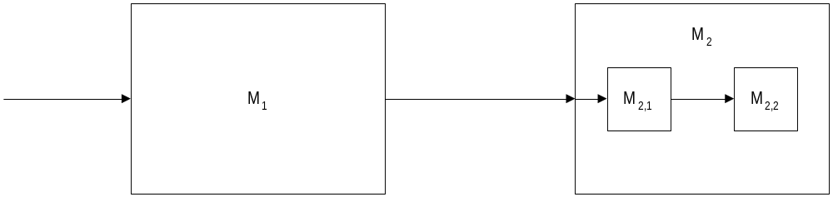
Integration: Bottom-Up or Top-Down
USES
USES
Figure 6.7 A GDN structure showing that M₁ USES M₂ and M₂ IS_COMPOSED_OF{M_{2,1}, M_{2,2}­}
Bottom up: ________________________________
Top down: ________________________________
Notes:
Third, partial aggregations of modules often constitute important subsystems that can have some autonomy. For instance, a complex office information system can integrate modules that perform financial computations, processing of documents, etc. Each of these modules, in turn, may consist of several modules such as invoiceDB, lettersDB, and personnelFiles. Clearly, it is worthwhile to test the integration of all the modules related to document processing independently of those having to do with financial processing, and conversely. This kind of testing will also help focus attention on critical relationships between the modules when one moves to higher level integration. Furthermore, if the subset provides a meaningful subsystem, it may be delivered to users according to an incremental delivery strategy.
Fourth, incremental testing can reduce or obviate the need for stubs or drivers. For instance, suppose you have a module file_manager that exports a set of traditional operations on files. After having tested this module separately, you may turn to testing a module table_manager that manages several kinds of tables stored in memory or in secondary storage. Thus, table_manager uses the file_manager module. You could decide to link table_manager to file_manager immediately and test the two of them together. This will allow you to avoid constructing stubs that simulate the operations of file_manager, and you will be able to test table_manager independently, with a good chance to localize possible errors.
Once the incrementality principle is accepted, the question arises, “In what order should modules be aggregated?” Two natural approaches to answering this question are bottom-up and top-down aggregation. The former means starting aggregation and testing from the leaves of the USES hierarchy. It requires the implementation of drivers to substitute for higher level modules. The latter means starting from top-level modules and using stubs to simulate lower level ones. The complementary benefits of the two approaches should be fairly obvious and are left to the reader to ponder. Also, mixed solutions could easily be designed to cope with peculiar cases.
The top-down and bottom-up approaches may be used – and combined – in several ways by following a software architecture described in terms of both the USES and the IS_COMPOSED_OF relations. For example, consider the GDN structure of Figure 6.7. We test M₁ by providing a stub for M₂ and a driver for M₁. Later, we can provide an implementation for M_{2,1} and a stub for M_{2,2}. Alternatively, we can first implement M_{2,2} and test it by using a driver, then we can design M_{2,1} and test the combination of M_{2,1} and M_{2,2} – which constitutes M₂ – by using a driver. Finally, we can implement M1 and test it along with M₂, using a driver for M₁.

Slide 69
Four Different Integration Patterns
Top-down integration
Bottom-up integration
Notes:
There are four different integration patterns. Top-down integration and bottom-up integration are shown here.

Slide 70
Four Different Integration Patterns
Sandwich integration
Build integration
Each build represents one major feature or function
Notes:
Sandwich integration combines both top-down and bottom-up integrations. In build integration, each build represents one major feature or function.

Slide 71
Separate Testing Concerns
Different types of testing
  functional testing
  performance testing
  overload testing (test the system behavior during peak condition)
  robustness testing (try to break the s/w)
  regression testing (verify possible regressions of s/w by repeated testing to avoid degradation of s/w quality)
Notes:
Testing a whole system is a complex activity that involves, in general, several phases, with different goals, performed by different people. For instance, some testing could be done by the developers of the software themselves, some could be done by other people belonging to the same company that produces the system, and some could be done by the customer, Also, some tests could be done to ensure functional correctness, others to ensure robustness, etc. Applying the principle of separation of concerns is a key to a successful testing strategy.
Recall that all software qualities should be verified and, therefore, possibly tested. This suggests that testing should address not only compliance with precisely stated functional requirements, but also performance, robustness, usability, and all other requested qualities. We can use the principle of separation of concerns to design test cases for different qualities: One test set is designed to check functional behavior, another is designed to check performance, and so on.
One should not, however, forget that even qualities which are not explicitly specified in the requirements document are worth verifying. As we saw in Topic 2, in practice it is often impossible to point out exhaustively and eactly all the requirements of a system; the requirements document should therefore be viewed as a minimal set of requirements for testing. The following discussion gives a sampling of the different concerns that we can address with specific kinds of tests.
Overload Testing: Suppose that a transaction system is required to execute at least 20 transactions per second with an average response time not to exceed 30 seconds. Then we should test how the system behaves during peak conditions, when, say 30 transactions are requested in a second. Such testing is called overload testing. It is likely that many ideas and suggestions for overload testing arise after the system is implemented, rather than during its specification. Of course, many of the results derived during such overload testing will be a source of inspiration for future enhancements of the system and also for the future development of similar systems.
Testing for Robustness: For much the same reason as in overload testing, we must test the system under unexpected conditions, such as erroneous user commands and power failures. Strictly speaking, it could seem a waste of time to schedule the testing of the system under unexpected conditions; instead, why not specify the expected response explicitly in the requirements document? The relevance of many unexpected conditions, however, may become clear only after some experience with early versions of the system.

Slide 72
A Note on Regression Testing
Regression Testing: Testing with the purpose of verifying possible ______________ of software during its life – i.e., degradations of correctness or other qualities due to later modifications.
x := c + 1; proc(z);
  proc(z); redesign c := c + 3;
  c := x + 2; ⇒ x := 3;
  x := 3;
Key: Properly designing and documenting test cases to make them _________________ .
Notes:
Regression Testing: Another concern that should be kept in mind during testing is that software will be modified during its lifetime, as we already have emphasized several times. For instance, suppose you are going to add new functionality to your software, or you are going modify a module to improve its response time. The changes, of course, many introduce errors into software that was previously correct. For example, suppose the program fragment:
x := c + 1;
proc(z);
c := x + 2;
x := 3;
Works properly. Now suppose that in a subsequent redesign it is transformed into
proc(z);
c := c + 3;
x := 3;
In an attempt at program optimization. This may result in an error if procedure proc accesses variable x.
Thus, we need to organize testing also with the purpose of verifying possible regressions of software during its life – that is, degradations of correctness or other qualities due to later modifications. Properly designing and documenting test cases with the purpose of making tests repeatable, as well as using test generators, will help regression testing. By contrast, the use of interactive human input reduces repeatability and thus hampers regression testing. In practice, regression testing is done by keeping an archive of previous test runs and their results and then rerunning all the archived tests for each new release of the product.
Finally, we must treat test cases in much the same way as software. It is clear that such factors as evolvability, reusability, and verifiability and just as important in test cases as they are in software. We must apply formality and rigor and all of our other principles in the development and management of test cases.

Slide 73
Concluding Remarks
Goals and requirements of verification
Testing schemes
  Testing in the small
    White-box testing
    Black-box testing
  Testing in the large
    Module testing
    Integration
Separation of concerns in testing
Notes:
We conclude this Topic by reviewing what we have learned.
We talked about goals and requirements of verification
We mainly focus on software testing schemes, which include
Testing in the small
White-box testing
Black-box testing
Testing in the large
Module testing
Integration
Separation of concerns in testing

